Slide 1


PT. Panasonic Industrial Devices Batam
PT. Cinovasi Rekaprima
USER GUIDE
Configure Workflow Setting
(Mar 31th, 2022)

Slide 2
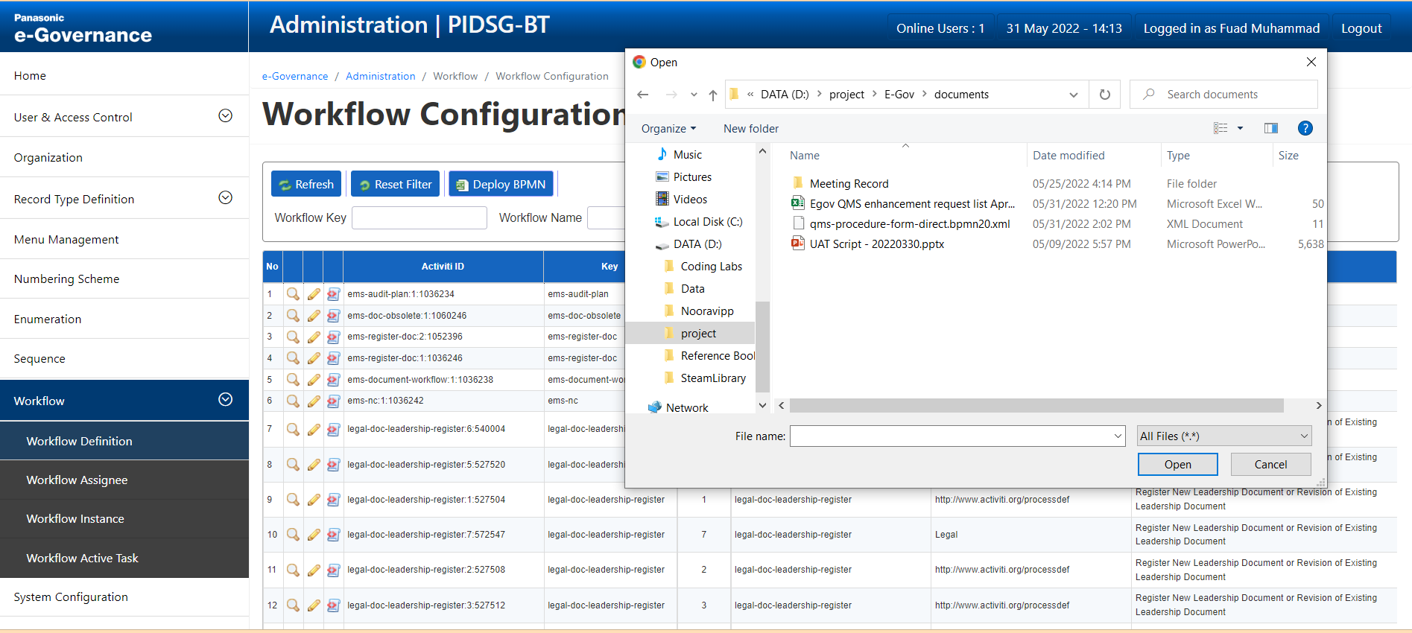
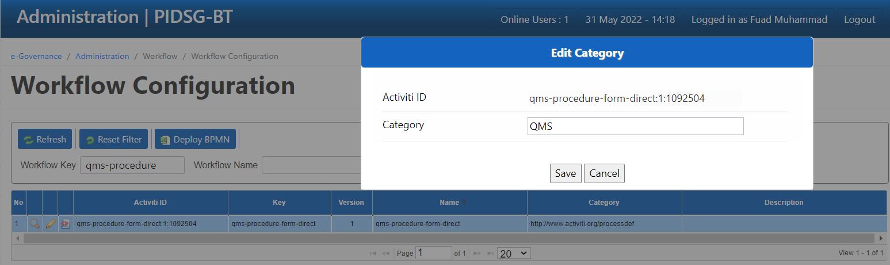
2
3
1
4
Change To “QMS”
6
5

Slide 3
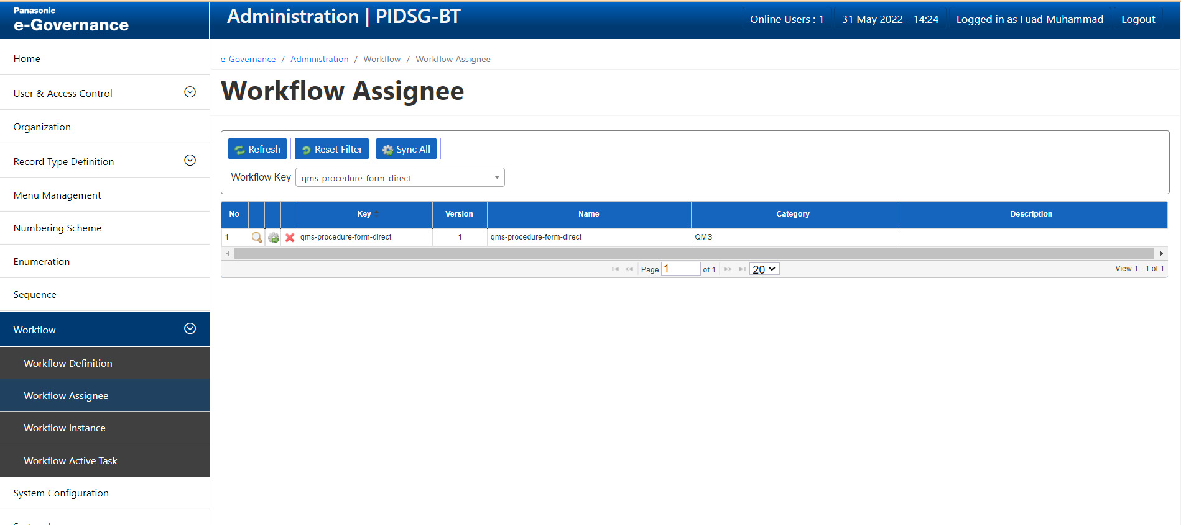
2
3
4
1

Slide 4
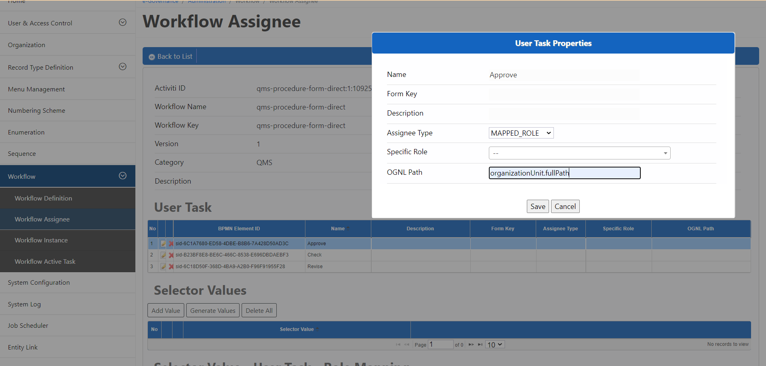
User Task Setting for Approver
2
3
4
1

Slide 5
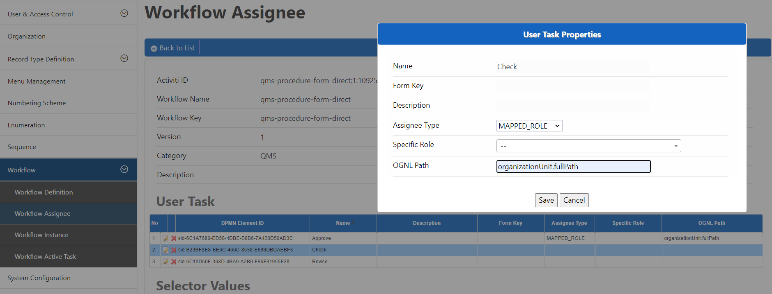
User Task Setting For Checker
2
3
4
1

Slide 6
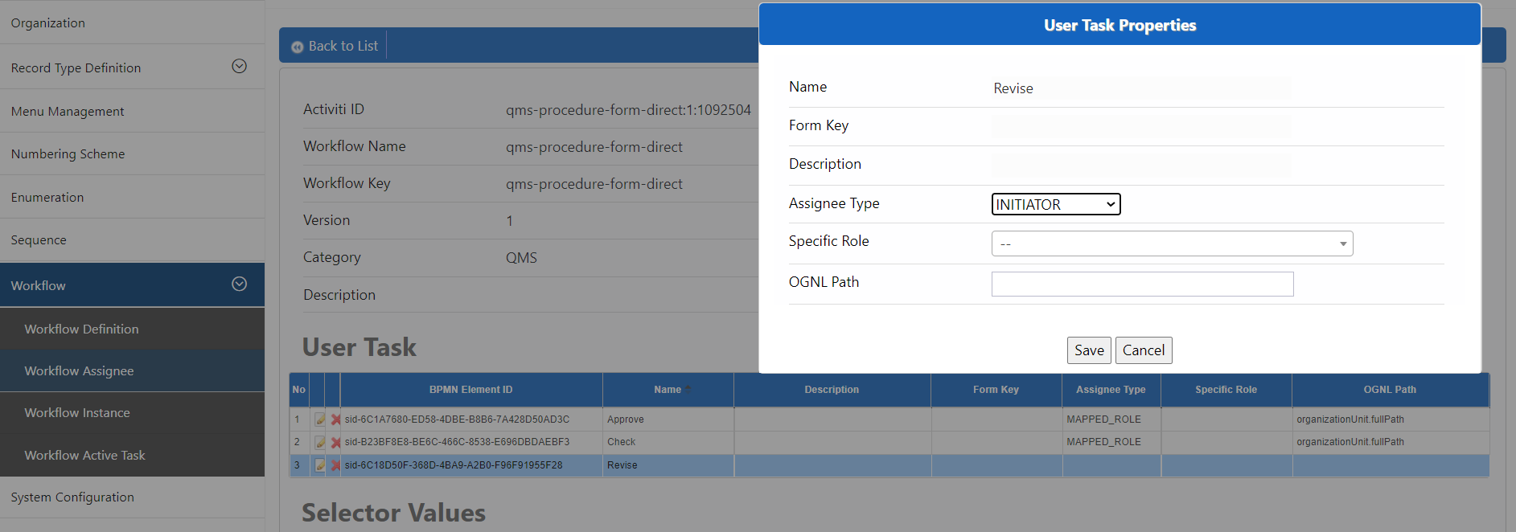
User Task Setting for Revise
2
3
1

Slide 7
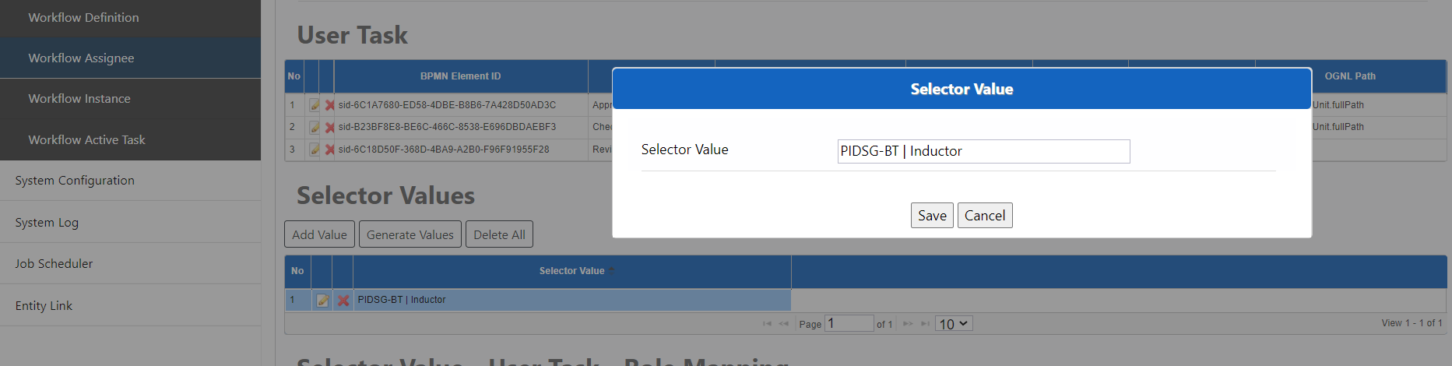
Note :
- Start selector with “PIDSG-BT” not with “QMS | PIDSG-BT”
Selector Values
2
1
3

Slide 8
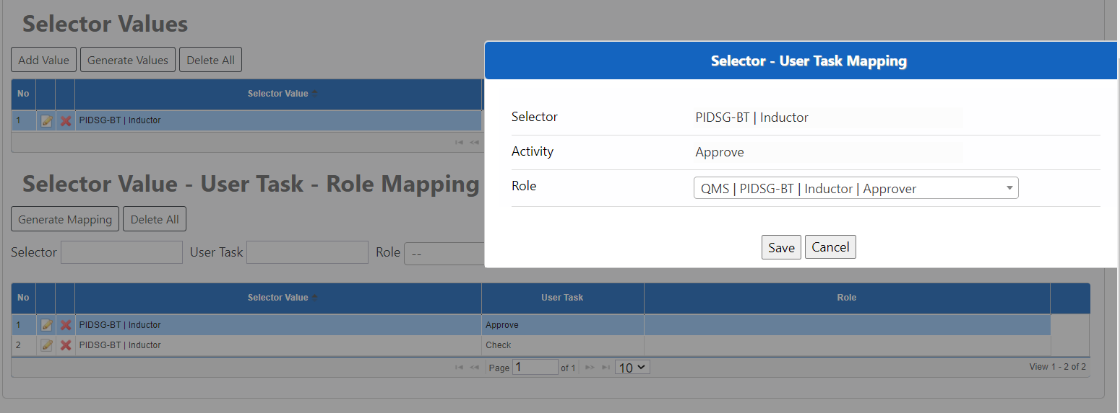
Choose Role for approver
2
3
1

Slide 9
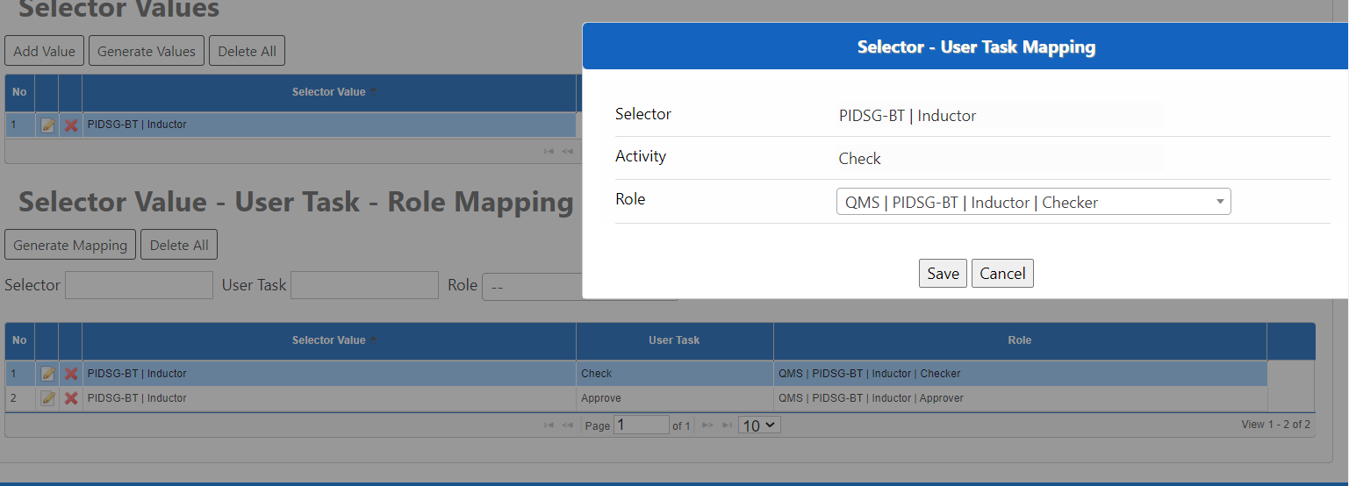
Choose Role for checker
2
3
1

Slide 10
Thank You

